Slide 1

DevOps
CIS 640 Guest Lecture
Spring 2022

Slide 2
software DEVelopment
+ it OPerations
=
DevOps
https://en.wikipedia.org/wiki/DevOps
Notes:
History – previously software took a long time to develop, required lots of work to package and deploy (sell).
With the internet, distribution became simpler
Also, software RUNS the internet
With Agile, the focus is on faster sprints between working products
Can we release those working products quickly enough to be useful?
Have to speed up and automate things A LOT

Slide 3
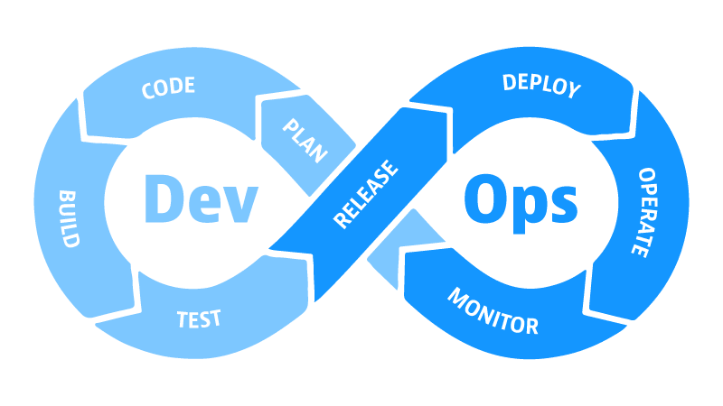
https://www.dynatrace.com/news/blog/what-is-devops/
Notes:
The DevOps Toolchain (Should feel like Agile)
Start by planning what you want to build
Write the code
Build the program
Test it.
If it passes, create a release and deploy
Then, while operating the software, monitor for defects, which feed back into the Agile backlog for the next sprint

Slide 4
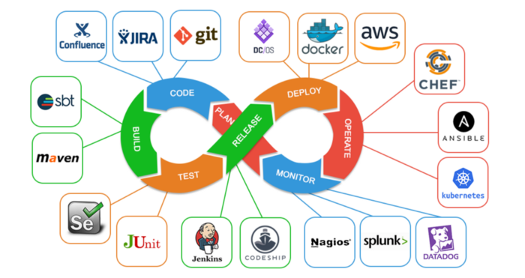
https://medium.com/swlh/how-to-become-an-devops-engineer-in-2020-80b8740d5a52

Slide 5
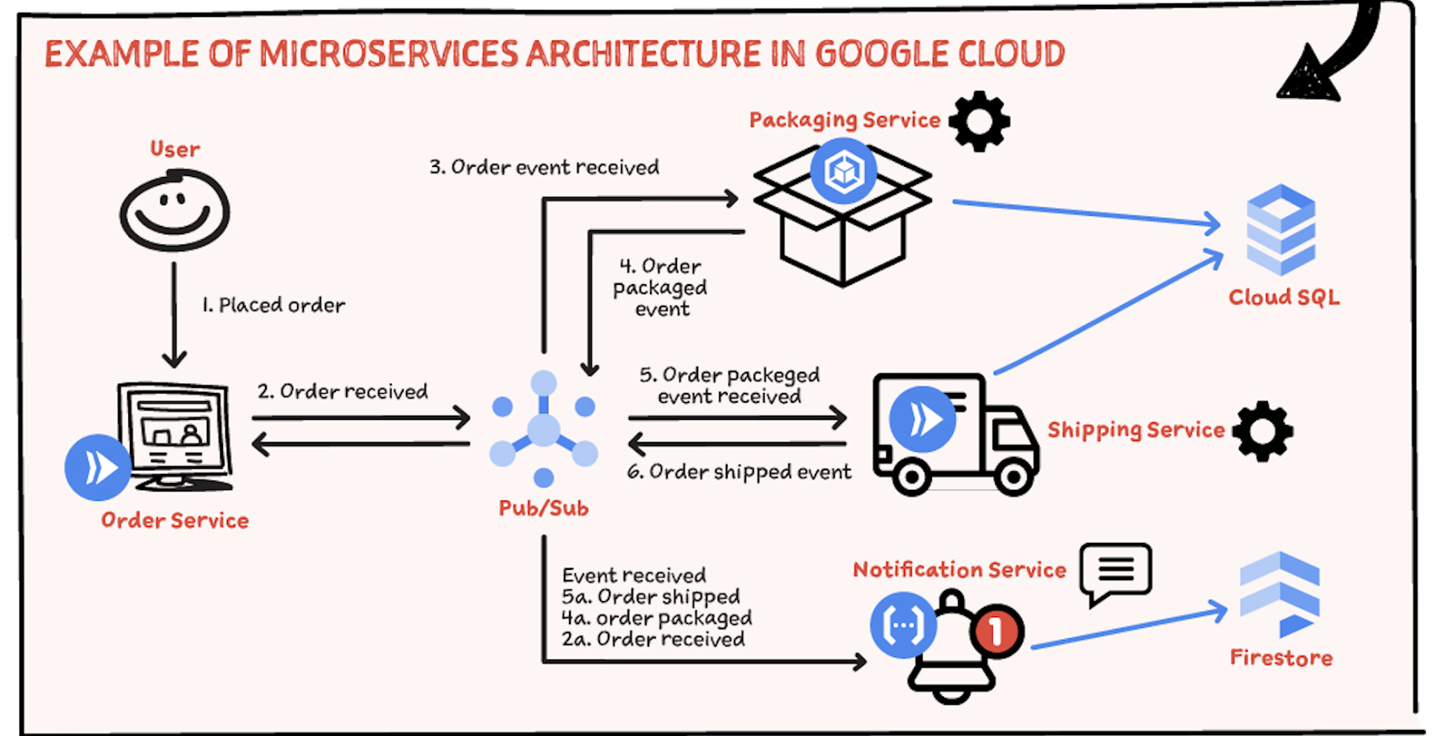
Plan: Microservices
https://cloud.google.com/blog/topics/developers-practitioners/microservices-architecture-google-cloud
Notes:
Microservices – small, independent applications with a clear API for interaction that can be deployed independently as they are updated.

Slide 6
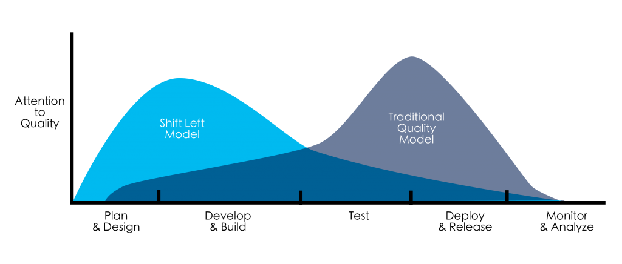
Shift Left
https://devopedia.org/shift-left
Notes:
Shift left – move tasks that used to happen later in the process, such as testing, to earlier in the proces

Slide 7
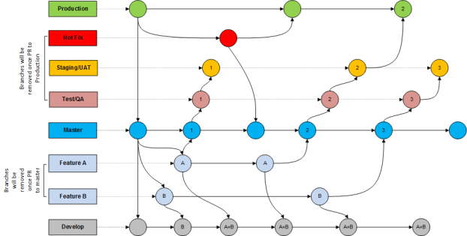
Code: Branching Strategy
https://born4joy.wordpress.com/2019/05/10/sitecore-devops-a-b-c/

Slide 8
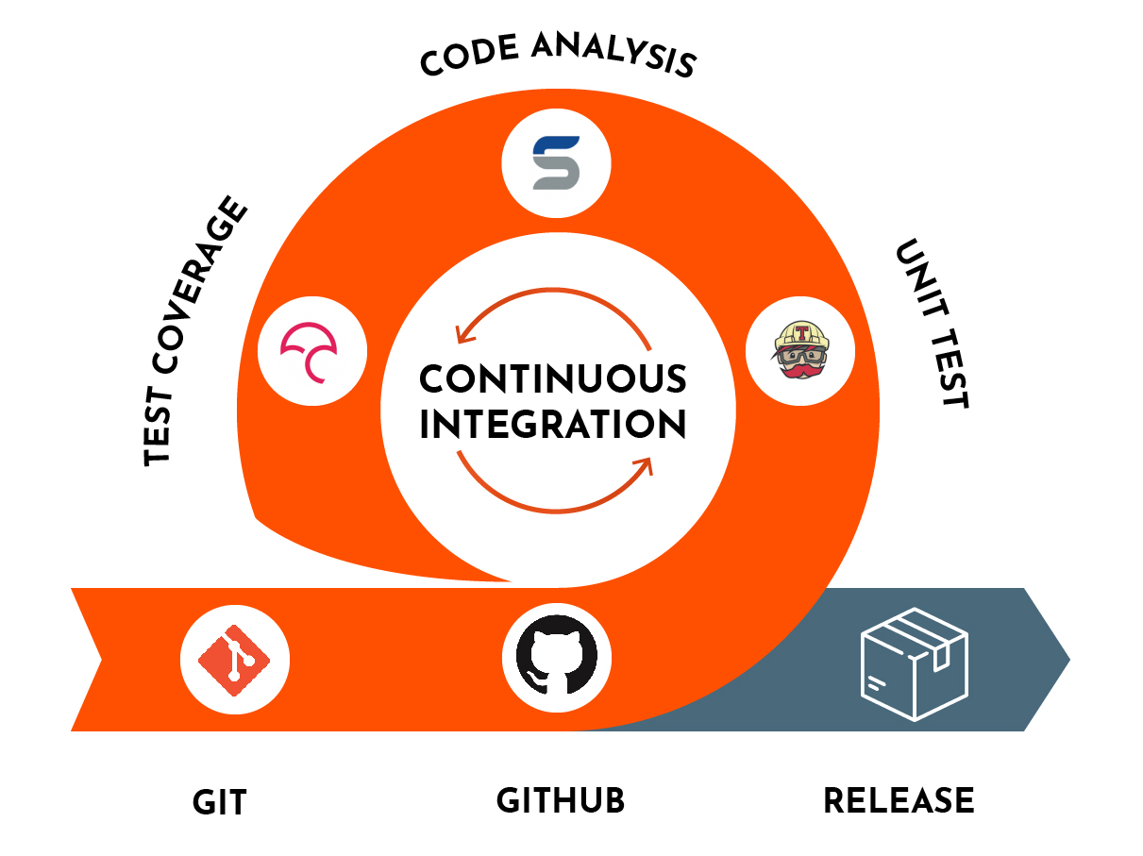
Continuous Integration
https://en.wikipedia.org/wiki/Continuous_integration
https://www.devonblog.com/continuous-delivery/continuous-integration-best-practices/
Notes:
Continuous integration – everyone is merging (integrating) their code frequently, several times a day
Keeps the software in an “always deployable” state
Eliminate the “works on my machine” problems
Visibility into the project – it can be built and run at any point
Commit frequently, don’t break the build!
Code quality audits are essential here!

Slide 9
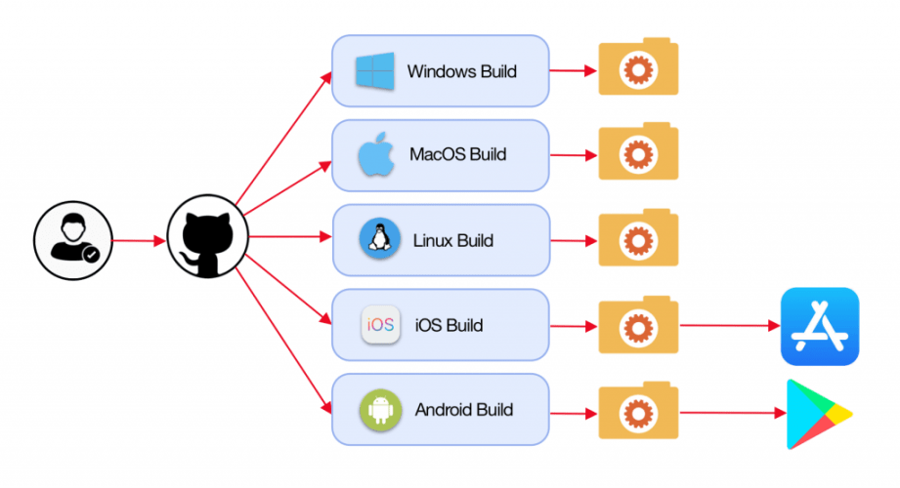
Build: Automation
https://gluonhq.com/use-github-actions-to-automate-your-gluon-build-and-release-cycle/

Slide 10
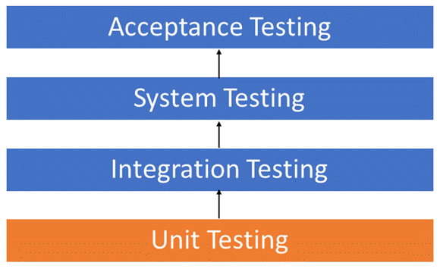
Test: Full Test Suites

Slide 11
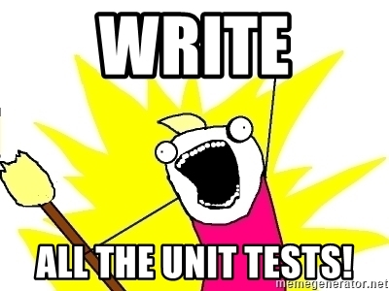

Slide 12
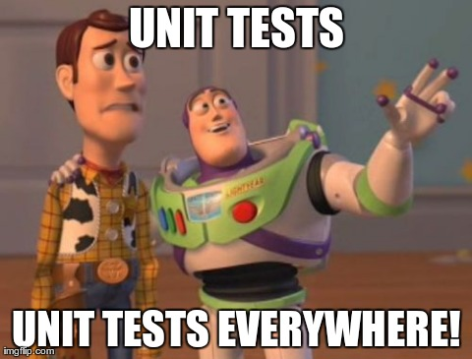

Slide 13
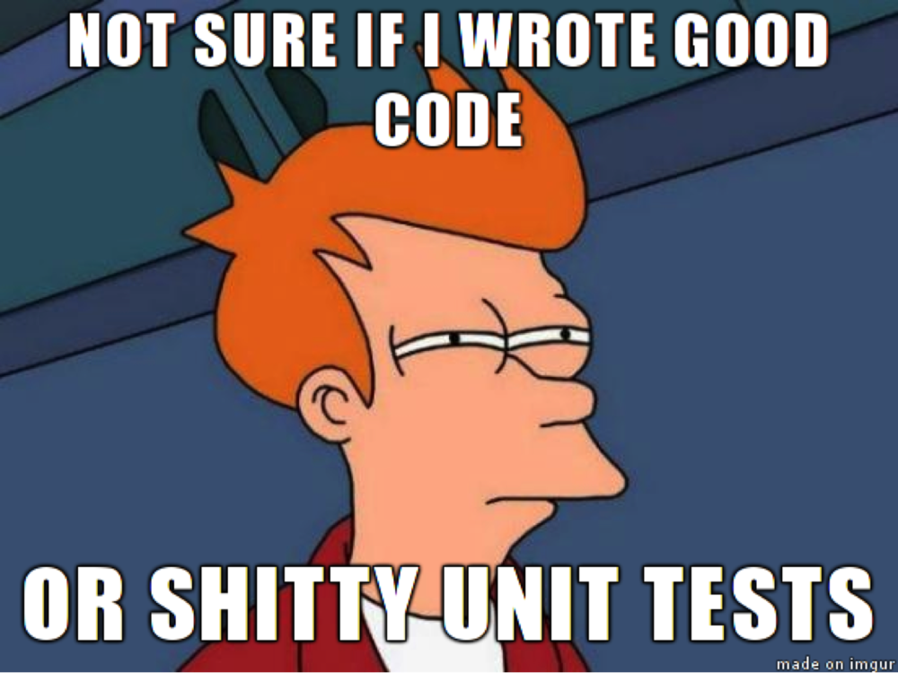

Slide 14
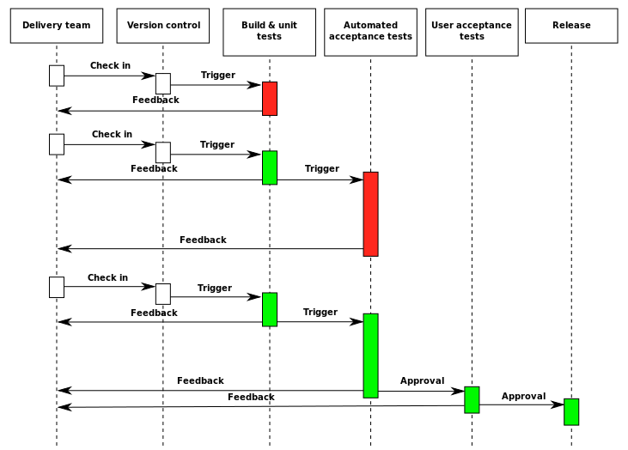
Release: Only if Tests Pass
That’s this
part here
https://en.wikipedia.org/wiki/Continuous_delivery

Slide 15
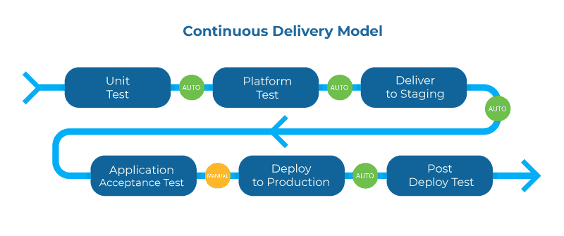
Continuous Delivery
https://www.plutora.com/blog/continuous-delivery-model

Slide 16
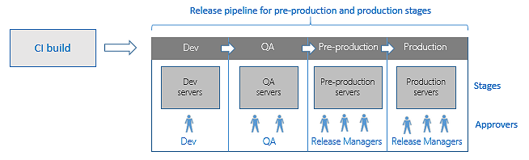
Deploy: Environments
https://docs.microsoft.com/en-us/azure/devops/pipelines/release/?view=azure-devops

Slide 17
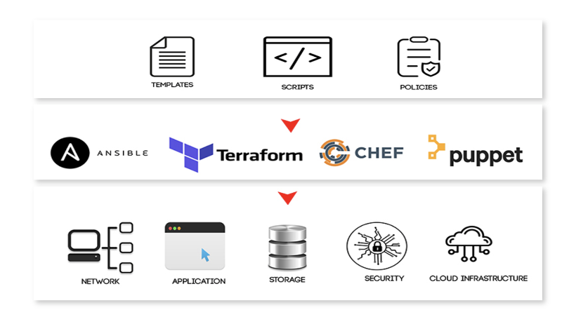
Operate: Infra as Code
https://dzone.com/articles/5-principles-of-infrastructure-as-code-iac

Slide 18
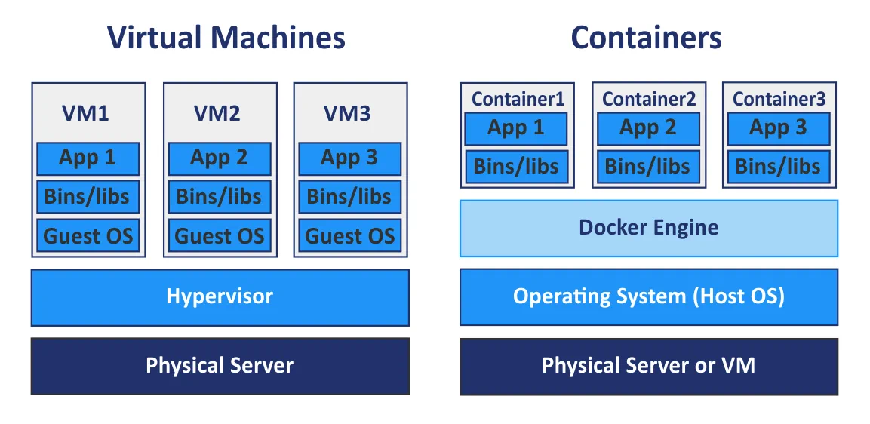
Docker
https://www.nakivo.com/blog/docker-vs-kubernetes/

Slide 19
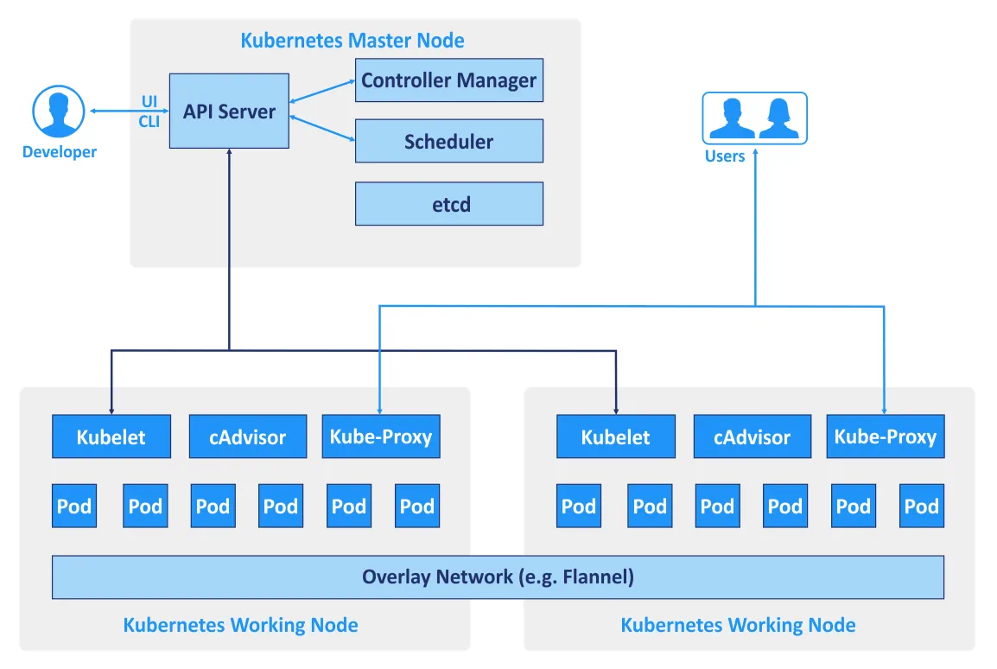
Kubernetes
https://www.nakivo.com/blog/docker-vs-kubernetes/

Slide 20
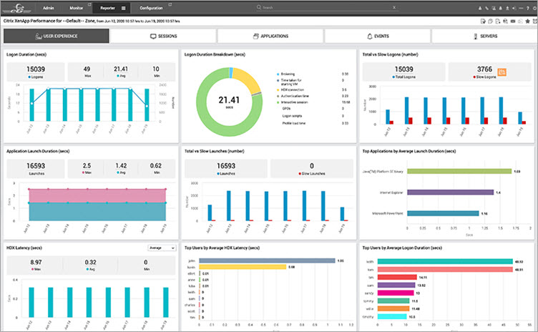
Monitor: Is it Working?
https://www.softwaretestinghelp.com/system-monitoring-software/

Slide 21
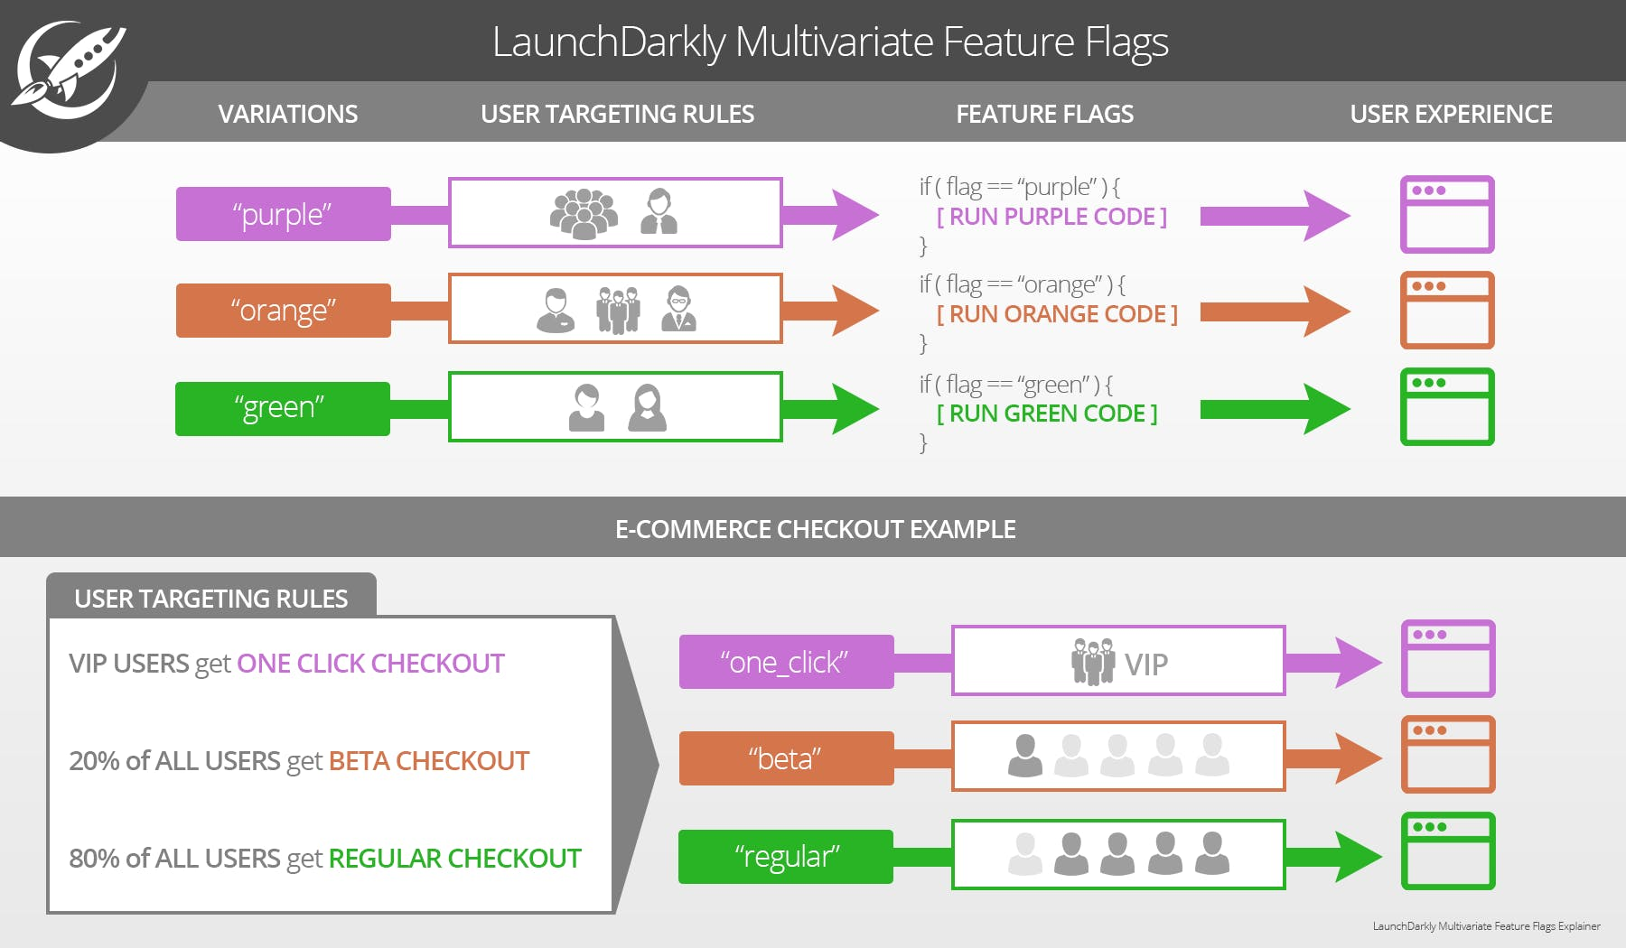
Feature Flags
https://launchdarkly.com/blog/feature-flag-driven-development/

Slide 22
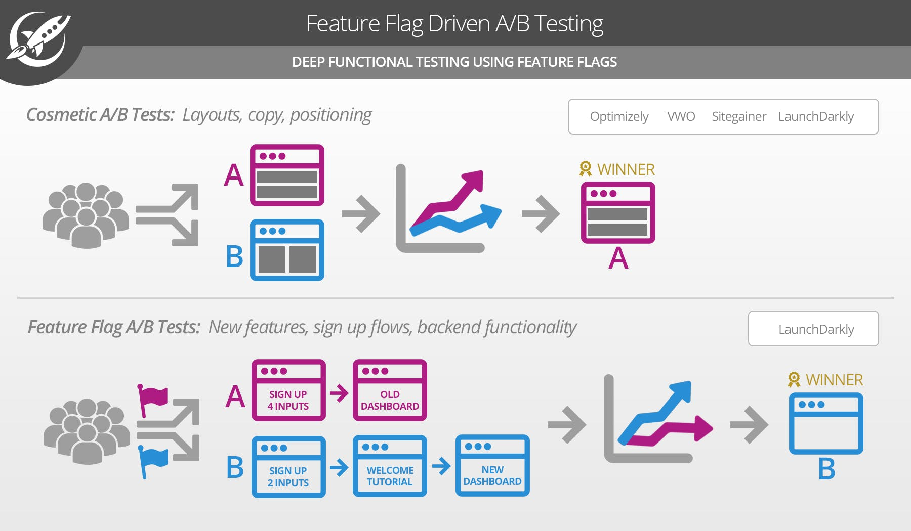
Feature Flags
https://launchdarkly.com/blog/feature-flag-driven-development/

Slide 23


Demo Time
GitHub Actions
GitLab Runner

Slide 24
Demo Time
GitHub Actions
GitLab Runner
YML Configuration
JavaScript & Docker
Marketplace
Workflows & Jobs
Triggers
GitHub API Access
YML Configuration
Docker
Shell Scripts
Workflows & Jobs
Triggers
GitLab API Access

Slide 25
Follow Along!
https://russfeld.me/talks

